Slide 1
C++ is not that horrible… really
Konrad Pagacz

Slide 2
Why is C++ taught at universities?
Teaches basics of algorithms:
Sequence of instructions executed by a computer, etc…
Teaches how processors work with memory
Is the most comprehensible:
Supports multiparadigm programming
Once you master C++, no other language will pose a problem, right?

Slide 3
Why is C++ a horrible language to learn?
Syntax is ridiculously complex… or is it?
Arguably limited usefulness?

Slide 4
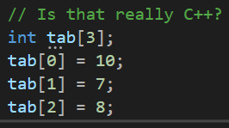


Allocators…

Slide 5
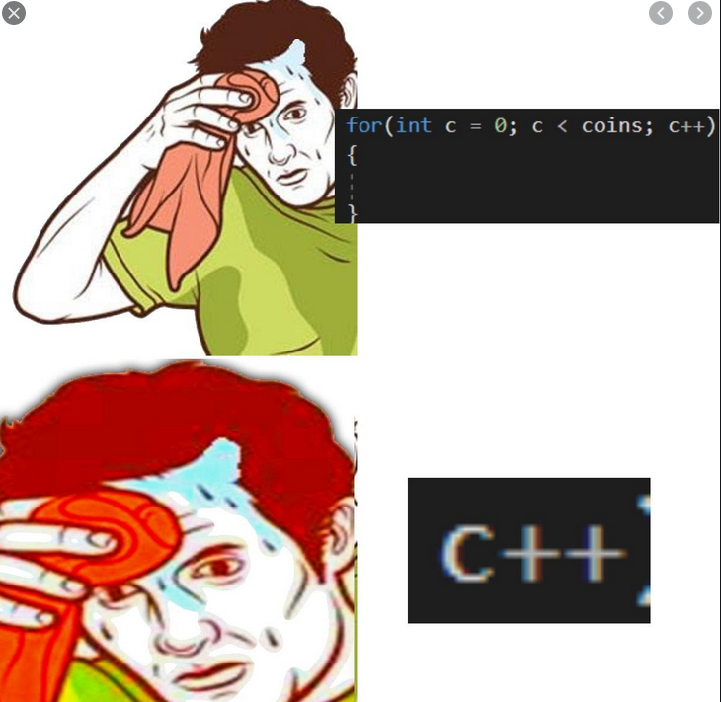
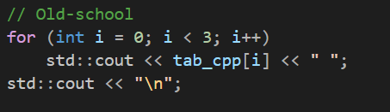
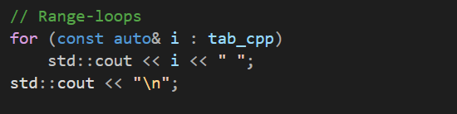
Looping over an array

Slide 6
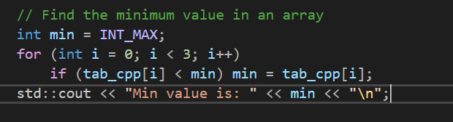

Finding the minimum value in an array
Std::max_element to look for the maximum.

Slide 7
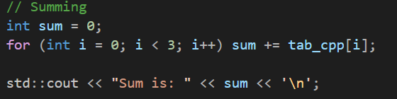
Sum elements of an array

Slide 8
Take home message
Know your standard library!
C++ has changed dramatically for the past few year, read up on it!
Universities should really start teaching C++ instead of C camouflaging as C++

